Slide 1
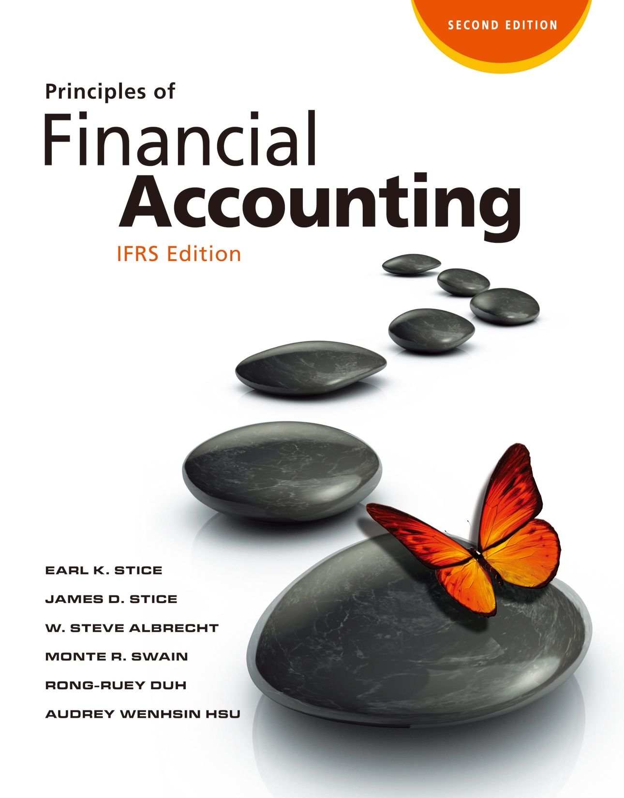

Slide 2
Inventory and the Cost of Sales

Slide 3
Inventory and the Cost of Sales

Slide 4
What is Inventory?
Inventory and Cost of Goods Sold
LO1
Inventory
Goods held for resale.
Cost of Goods Sold
The costs incurred to purchase or manufacture the merchandise sold during a period.

Slide 5
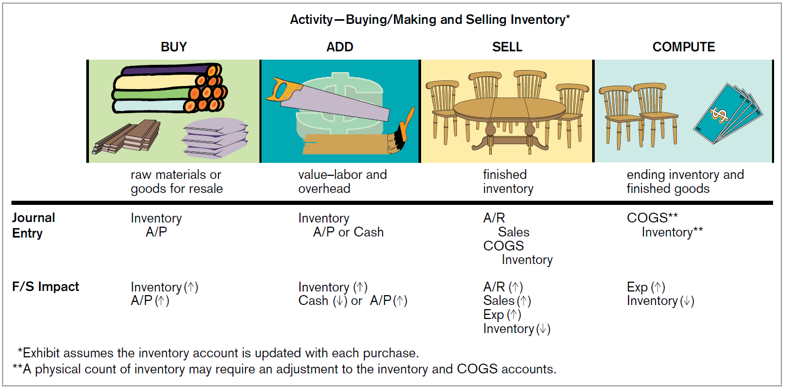
What is Inventory?
LO1
Activity: Buying/Making and Selling Inventory
Exhibit 7.2

Slide 6
What is Inventory?
LO1
Inventory
Three different types of inventory in a manufacturing company
Raw materials: materials purchased for use in manufacturing process.
Work in process: partially completed units in production.
Finished goods: manufactured products ready for sale.

Slide 7
What is Inventory?
LO1
Costs Included in Inventory Cost
Inventory cost consists of all costs involved in buying the inventory and preparing it for sale.
Raw materials
Labor costs
Manufacturing overhead: The indirect manufacturing costs associated with producing inventory.
Freight-in costs

Slide 8
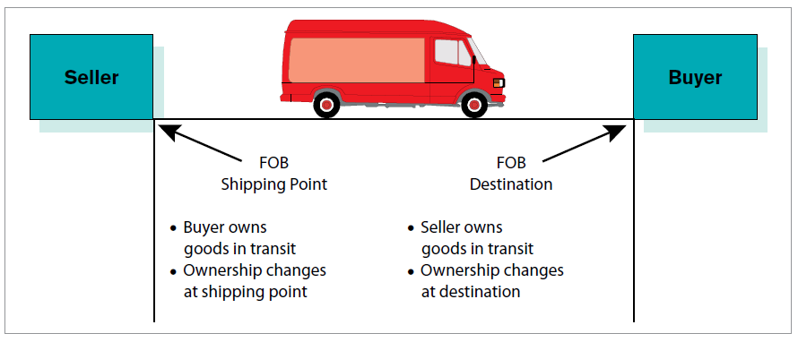
Who Owns the Inventory?
LO1
Goods Being Shipped
FOB (free-on-board) destination
FOB (free-on- board) shipping point
Exhibit 7.3

Slide 9


Who Owns the Inventory?
LO1
Goods on Consignment
The consignors provide inventory to consignee for resale while retaining ownership of the inventory until it is sold.
consignor
consignee
Keeping ownership

Slide 10
Ending Inventory and Cost of Goods Sold
LO1
Cost of Goods Available for Sale
The Cost Allocation Process
Beginning
inventory
Inventory
purchased
Cost of Goods
Available for Sale
+
=
Ending
inventory
Cost of Goods
Available for Sale
Cost of
Goods sold

Slide 11
Perpetual vs. Periodic System
Accounting for Inventory Purchases and Sales
LO2
Perpetual Inventory System
Detailed records of the number of units and the cost of each purchase and sale are prepared THROUGHOUT the period.
Periodic Inventory System
System of accounting where cost of goods sold is determined and inventory is adjusted at the END of the accounting period, not when merchandise is purchased or sold.

Slide 12
Perpetual vs. Periodic System
LO2
Illustration-Purchases
Followings are transactions of Grantsville Clothing Store:
Purchased on account: 1,000 shirts at a cost of $10 each for a total of $10,000.
Purchased on account: 300 pairs of pants at a cost of $18 each for a total of $5,400.
Perpetual |  |  | Periodic
a. Inventory | 10,000 |  | Purchases | 10,000
Accounts Payable |  | 10,000 | Accounts Payable |  | 10,000
b. Inventory | 5,400 |  | Purchases | 5,400
Accounts Payable |  | 5,400 | Accounts Payable |  | 5,400

Slide 13
Perpetual vs. Periodic System
LO2
Illustration-Transportation Costs
Paid cash for separate shipping costs on the shirts purchased in (a), $970.
Perpetual |  |  | Periodic
c. Inventory | 970 |  | Freight In | 970
Cash |  | 970 | Cash |  | 970

Slide 14
Perpetual vs. Periodic System
LO2
Illustration-Purchase Return
Returned 30 of the shirts (costing $300) to the supplier because they were stained.
Perpetual |  |  | Periodic
d. Accounts Payable | 300 |  | Accounts Payable | 300
Inventory |  | 300 | Purchase Returns |  | 300

Slide 15
Perpetual vs. Periodic System
LO2
Illustration-Purchase Discounts
Paid for the shirt purchase. A 2% discount was given on the $9,700 bill [(1,000 purchased − 30 returned) × $10] because of payment within the 10-day discount period (payment terms were 2/10, n/30).
Perpetual |  |  | Periodic
e. Accounts Payable | 9,700 |  | Accounts Payable | 9,700
Inventory |  | 194 | Purchase Discounts |  | 194
Cash |  | 9,506 | Cash |  | 9,506

Slide 16
Perpetual vs. Periodic System
LO2
Illustration-Purchase Discounts
Paid $5,400 for the pants purchase. No discount was allowed because payment was made after the discount period.
Perpetual |  |  | Periodic
f. Accounts Payable | 5,400 |  | Accounts Payable | 5,400
Cash |  | 5,400 | Cash |  | 5,400

Slide 17
Perpetual vs. Periodic System
LO2
Illustration-Sale
Sold on account: 600 shirts at a price of $25 each for a total of $15,000.
Perpetual |  |  | Periodic
Accounts Receivable | 15,000 |  | Accounts Receivable | 15,000
Sales (600 x $25) |  | 15,000 | Sales |  | 15,000
Cost of Goods Sold | 6,000
Inventory |  | 6,000

Slide 18
Perpetual vs. Periodic System
LO2
Illustration-Sale
Sold on account: 200 pairs of pants at a price of $40 each for a total of $8,000.
Under periodic system, Grantsville would not even know how many shirts and how many pairs of pants had been sold. Only total sales of $23,000 would be known.
Perpetual |  |  | Periodic
h. Accounts Receivable | 8,000 |  | Accounts Receivable | 8,000
Sales (200 x $40) |  | 8,000 | Sales |  | 8,000
Cost of Goods Sold | 3,600
Inventory (200 x $18) |  | 3,600

Slide 19
Perpetual vs. Periodic System
LO2
Illustration-Sale
The cost of goods sold for the shirts recorded here is $10 each. The actual cost per shirt, after adjusting for freight in and purchase discounts, is $10.80, computed as follows:
Total purchase price (1,000 shirts) | $10,000
Plus: Freight in | 970
Less: Purchase returns (30 shirts) | (300)
Less: Purchase discounts | (194)
Total cost of shirts (970 shirts) | $10,476
Total cost $10,476 ÷ 970 shirts = $ 10.80 per shirt

Slide 20
Perpetual vs. Periodic System
LO2
Illustration-Sale Returns
Accepted return of 50 shirts by dissatisfied customers.
Perpetual |  |  | Periodic
i. Sales Returns (50 x $25) | 1,250 |  | Sales Returns | 1,250
Accounts Receivable |  | 1,250 | Accounts Receivable |  | 1,250
Inventory (50 x $10) | 500
Cost of Goods Sold |  | 500

Slide 21
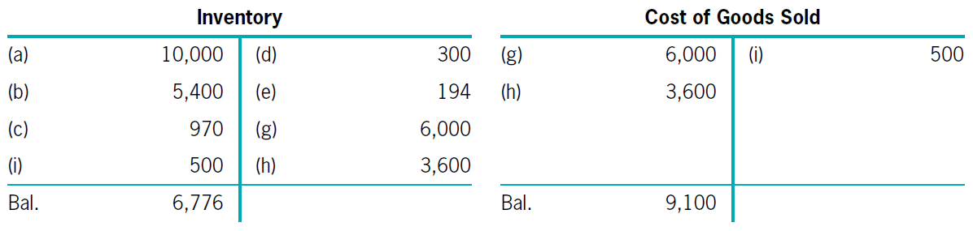
Perpetual vs. Periodic System
LO2
Illustration-Closing Entries
Perpetual System
(Ending) Inventory
on the B/S
Cost of goods sold on the S/CI

Slide 22
Perpetual vs. Periodic System
LO2
Illustration-Closing Entries
Periodic System: the correct balances can only be determined after an actual count of the ending inventory.
Step 1: Transfer all the temporary account balance to the inventory account.
Net Purchases
Inventory
15,876
Purchase Returns
300
Purchase Discounts
194
Freight In
970
Purchases
15,400
Closing of temporary inventory accounts for periodic system.

Slide 23
Perpetual vs. Periodic System
LO2
Illustration-Closing Entries
Step 2: Reduce Inventory by the amount of Cost of Goods Sold.
The year-end physical count: $6,776
Cost of Goods Sold
9,100
Inventory ($15,876 - $6,776)
9,100
Adjustment of inventory account to appropriate ending balance.

Slide 24
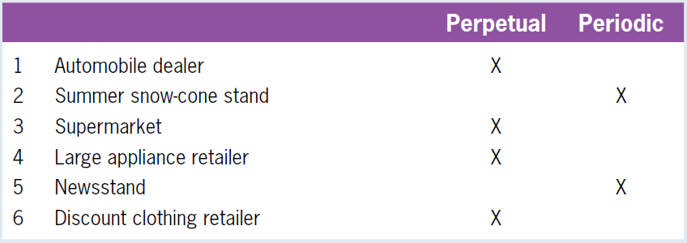
Quiz Yourself
LO2
For each of the following businesses, indicate whether the business would be more likely to use a perpetual or a periodic inventory system.
Solution

Slide 25
Taking a Physical Count of Inventory
Counting Inventory and Calculating Cost of Goods Sold
LO3
Periodic System
A physical count is the only way to get the information necessary to compute cost of goods sold.
Perpetual System
Physical counts allow companies to determine inventory shrinkage.
Two Steps for Physical Count of Inventory
Quantity count
Inventory costing

Slide 26
Taking a Physical Count of Inventory
LO3
Illustration
 | Periodic System | Perpetual System
Beginning inventory | $ 0 | $ 0
Plus: Net purchases | 15,876 | 15,876
Cost of goods available for sale | $15,876 | $ 15,876
Less: Ending inventory
Cost of goods sold
Goods lost or stolen
Total cost of goods sold, lost, or stolen
From inventory system
Physical count
5,950
6,776
$ 9,926
$ 9,100
unknown
826
$ 9,926
$ 9,926
$6,776 - $5,950

Slide 27
Taking a Physical Count of Inventory
LO3
Illustration-Perpetual Inventory System
The adjusting entry needed to record the inventory shrinkage when using a perpetual inventory system is as follows:
Inventory shrinkage
Cost of Goods Sold
826
Inventory ($6,776 - $5,950)
826
Adjustment of perpetual inventory balance to reflect inventory shrinkage.

Slide 28
Taking a Physical Count of Inventory
LO3
Illustration-Periodic Inventory System
With a periodic inventory system, no journal entry for inventory shrinkage is made because the amount of shrinkage is unknown.
Using the $5,950 ending inventory amount, the appropriate periodic inventory closing entry is:
Cost of Goods Sold
9,926
Inventory ($15,876 - $5,950)
9,926
Adjustment of inventory account to appropriate ending balance.

Slide 29
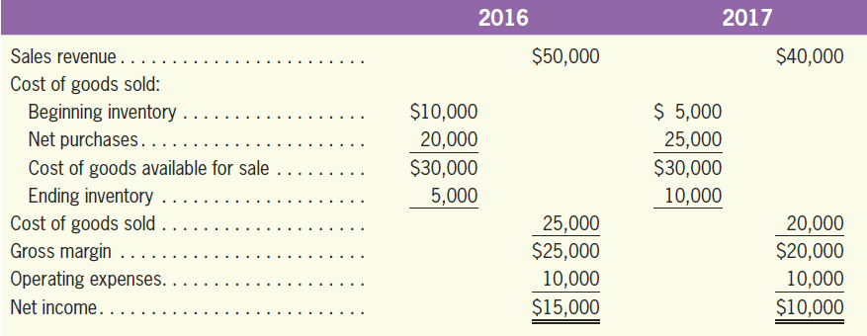
Inventory Errors
LO3
Illustration
Assume the following correct data for Salina Corporation:

Slide 30
Effects of an Ending Inventory Error on Current and Next Periods
LO3
Illustration
Now suppose that ending inventory in 2016 was overstated; that is, the count erroneously showed $7,000 of inventory on hand.
 | 2016 |  | 2017
Sales revenue |  | $50,000
Cost of goods sold:
Beginning inventory | $10,000
Net purchases | 20,000
Cost of goods available for sale | $30,000
Ending inventory
Cost of goods sold
Gross margin
Operating expenses
Net income
$40,000
$ 7,000
↓
25,000
$32,000
↓
10,000
7,000
↓
23,000
↓
22,000
↓
$27,000
↓
$18,000
↓
10,000
10,000
$17,000
↓
$ 8,000
↓

Slide 31
Quiz Yourself
LO3
Beginning inventory was $50,000. Purchases for the period total $760,000. A physical count at the end of the period revealed ending inventory of $62,500. Compute cost of goods sold for the period.
Solution
Beginning inventory ………………………………. | $ 50,000
Plus purchases ………………………………….. | 760,000
Goods available for sale …………………………. | $810,000
Less ending inventory ……………………………. | - 62,500
Cost of goods sold ………………………………... | $747,500

Slide 32
Quiz Yourself
LO3
Davis Company uses a periodic inventory system. Ending inventory for this period was understated by $150,000. What will be the effect of this error on this period’s net income? Next period’s net income?

Slide 33
Quiz Yourself
LO3
Solution
For this period, ending inventory will be understated by $150,000, which means cost of goods sold will be overstated by $150,000.
If cost of goods sold is overstated, then income will be understated by $150,000 (ignoring taxes).
Next period, the effect will be exactly the opposite. Beginning inventory will be too low, which means cost of goods sold will be understated by $150,000, and net income will be overstated by $150,000.

Slide 34
Cost Formulas for Inventory
Cost Formulas for Inventory
LO4
FIFO (first in, first out)
LIFO (last in, first out)
Weighted Average Cost
Specific Identification
IFRS does not allow the use of LIFO.

Slide 35
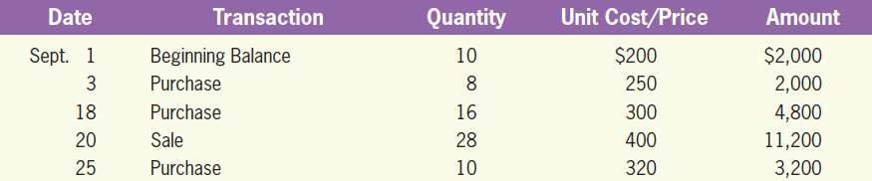
Cost Formulas for Inventory
LO4
Illustration
Assume that the periodic system is adopted, consider the September 2017 records of Nephi Company, which sells one type of bicycle.

Slide 36
Specific Identification Cost Formula
LO4
Each item is specifically identified.
Usually used for large or expensive items.
Illustration
Suppose that of the 28 bicycles sold by Nephi on September 25, 8 came from the beginning inventory, 4 came from the September 3 purchase, and 16 came from the September 18 purchase.

Slide 37
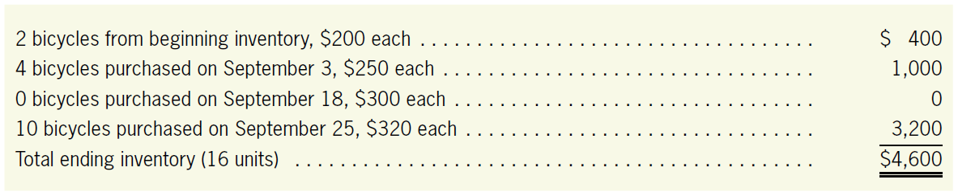
Specific Identification Cost Formula
LO4
Illustration
The cost of ending inventory is the total of the individual costs of the bicycles still on hand at the end of the month.

Slide 38
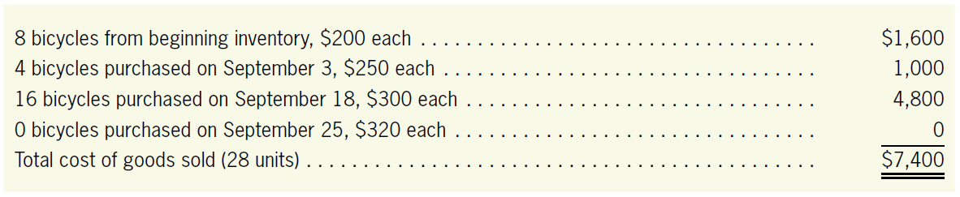
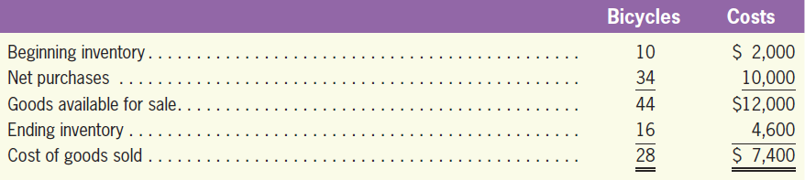
Specific Identification Cost Formula
LO4
Illustration
The cost of goods sold is the total of the costs of the specific bicycles sold.

Slide 39
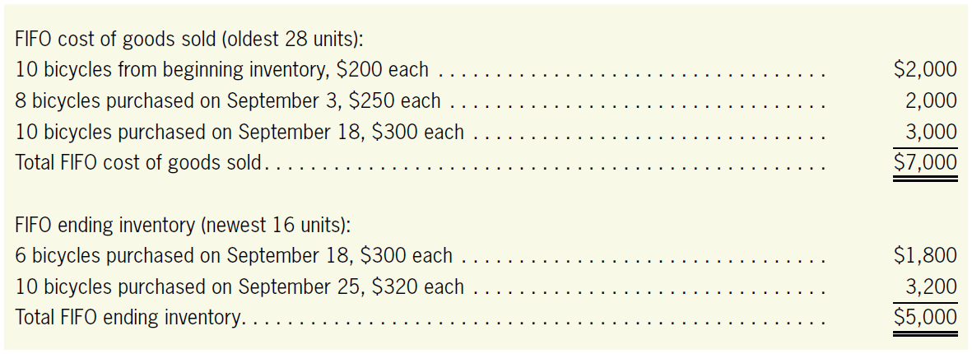
FIFO Cost Formula
LO4
It is assumed that the oldest units are sold and the newest units remain in inventory.
Illustration

Slide 40
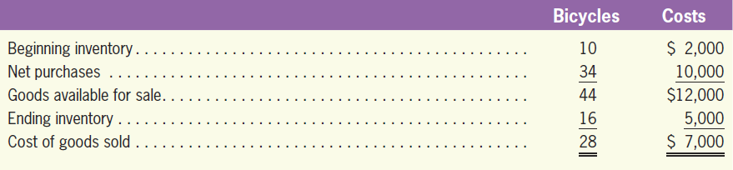
FIFO Cost Formula
LO4
Illustration

Slide 41
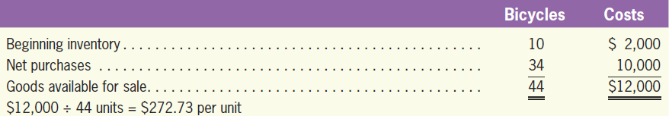
Weighted Average Cost Formula
LO4
With weighted average cost formula, a weighted average cost must be computed for all the inventory available for sale during the period.
Illustration

Slide 42
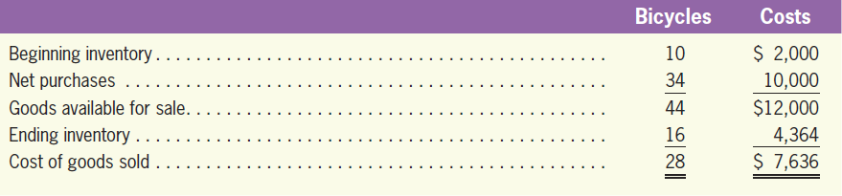
Weighted Average Cost Formula
LO4
Illustration
Weighted Average Cost of Goods Sold: 28 units x $272.73 per unit=$7,636 (rounded)
Weighted Average Ending Inventory: 16 units x $272.73 per unit=$4,364 (rounded)

Slide 43
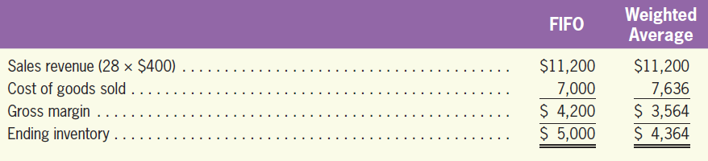
FIFO vs. Weighted Average Cost Formula
LO4
Comparison
When prices are increasing, companies tend to prefer FIFO because the performance looks better.
From the perspective of financial position, FIFO measures inventory value better because it approximates current cost.

Slide 44
Quiz Yourself
LO4
Zielesch Company reports the following activity during March related to its inventory of watches:
Determine (a) the cost of goods sold for the month and (b) the ending inventory balance for March 31 using
FIFO cost formula
Weighted average cost formula
Mar. | 1 | Beginning inventory consisted of 6 watches costing $40 each.
 | 5 | Purchased 10 watches costing $ 45 each.
 | 11 | Purchased 7 watches costing $48 each.
 | 22 | Purchased 11 watches costing $50each.
 | 27 | Sold 27 watches for $150 each.

Slide 45
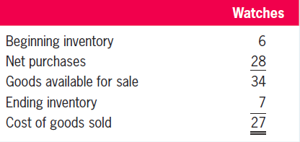
Quiz Yourself
LO4
Solution

Slide 46
Quiz Yourself
LO4
Solution
FIFO cost formula
FIFO cost of goods sold
FIFO ending inventory
6 watches from beginning inventory,$40 each | $ 240
10 watches purchased March 5, $45 each | 450
7 watches purchased March 11, $48 each | 336
4 watches purchased March 22, $50 each | 200
Total cost of goods sold (27units) | $ 1,226
7 watches purchased March 22, $50 each | $ 350

Slide 47
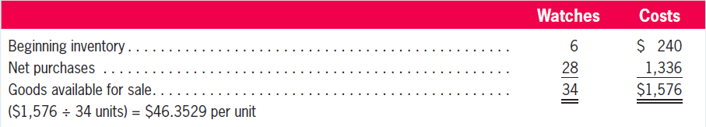
Quiz Yourself
LO4
Solution
Weighted average cost formula
Weighted average cost of goods sold
Weighted average ending inventory
27 units ⨉ $46.3529 per unit = $1,252 (rounded)
7 units ⨉ $46.3529 per unit = $324 (rounded)

Slide 48
Inventory Valued at Net Realizable Value
Valuing and Reporting Inventory at the Lower of Cost or Net Realizable
LO5
Net Realizable Value
The selling price of an item less reasonable selling costs.
Lower of Cost or Net Realizable Value
Compare the inventory cost to its net realizable value, and report the lower of cost or net realizable value on the balance sheet.

Slide 49
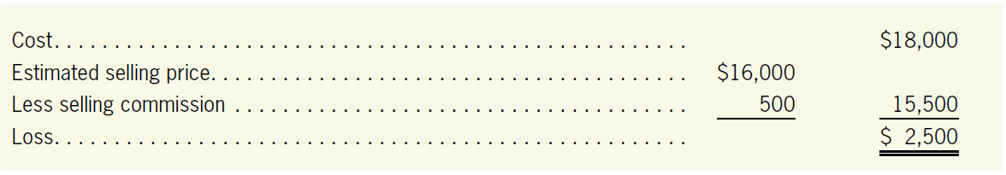
Inventory Valued at Net Realizable Value
LO5
Illustration
An automobile dealer has a demonstrator car that originally cost $18,000 and now can be sold for only $16,000. A commission of $500 must be paid to sell the car.
Cost of Goods Sold
2,500
Allowance for Inventory Write-Down
2,500
To write down inventory to its net realizable value.
a contra account to Inventory

Slide 50
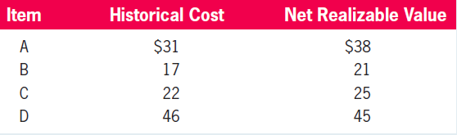
Quiz Yourself
LO5
For each of the following, identify the appropriate inventory value to be reported on the balance sheet by comparing with historical cost with the net realizable value.
Solution
Item A—$31 Item B—$17
Item C—$22 Item D—$45

Slide 51
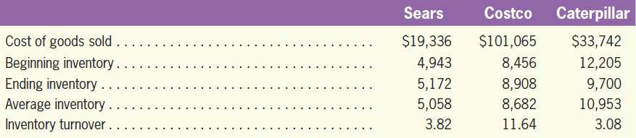
Evaluating the Level of Inventory
Assessing How Well Companies Manage Their Inventories
LO6
Inventory Turnover
Provides a measure of how many times a company turns over, or replenishes, its inventory during a year.
Cost of Goods Sold
Inventory Turnover =
Average Inventory

Slide 52
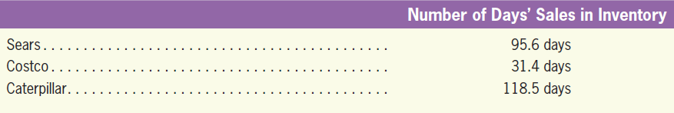
Evaluating the Level of Inventory
LO6
Number of Days’ Sales in Inventory
Provides a measure of how many days’ worth of sales does the company have in inventory.
Number of Days’
Sales in Inventory
365
=
Inventory Turnover

Slide 53
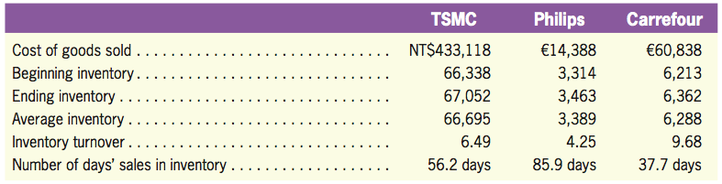
Evaluating the Level of Inventory
LO6
Illustration

Slide 54
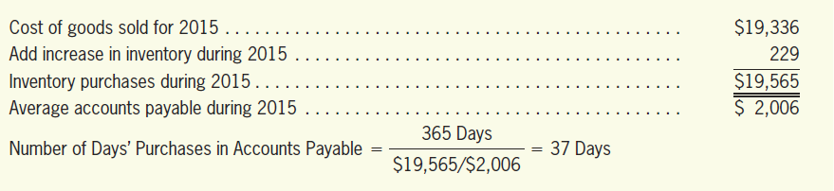
Number of Days’ Purchases in Accounts Payable
LO6
Provides a measure of how many days’ worth of inventory does the company have in accounts payable.
Illustration
Number of Days’ Purchases in Accounts Payable
365
=
Purchases / Average Accounts Payable

Slide 55
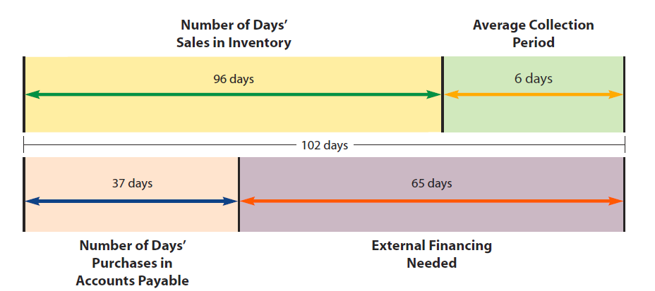
Number of Days’ Purchases in Accounts Payable
LO6
Illustration
Sears’ 103-day operating cycle for 2015.

Slide 56
Quiz Yourself
LO6
Skiba Company reported the following information for the year:
Compute (1) inventory turnover and (2) number of days’ sales in inventory.
Ending inventory | $3,000
Cost of goods sold | 4,200
Beginning inventory | 2,600

Slide 57
Quiz Yourself
LO6
Solution
Inventory Turnover
$4,200/[($2,600 + $3,000)/2] = 1.50 times
Number of Days’ Sales in Inventory
365/1.50 = 243.33 days

Slide 58
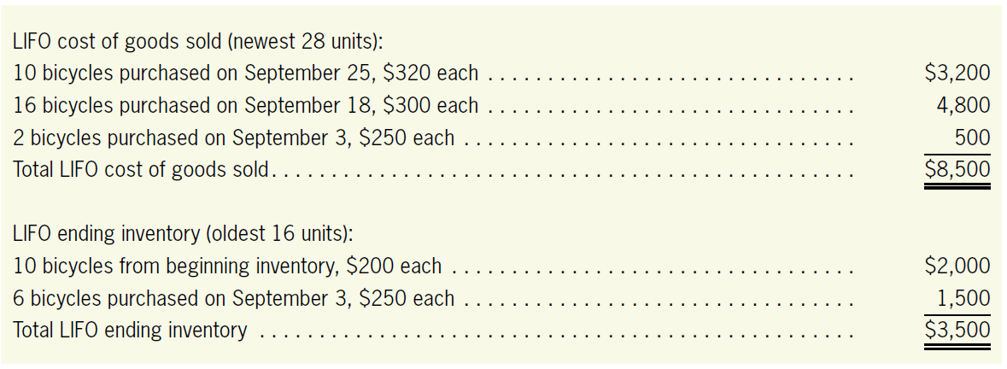
LIFO Cost Formula*
LIFO Cost Formula
LO7
LIFO is the opposite of FIFO. With LIFO, the cost of the most recent units purchased is transferred to cost of goods sold.
Illustration
Using the LIFO inventory cost flow assumption, the cost of goods sold and ending inventory for Nephi are:

Slide 59
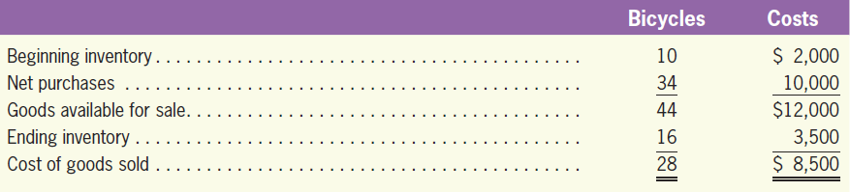
LIFO Cost Formula*
LO7
Illustration

Slide 60
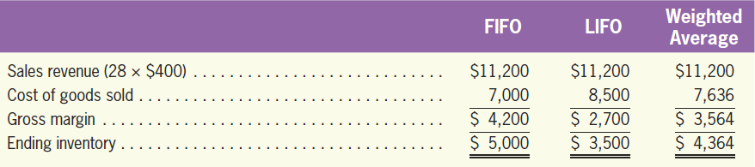
Comparison of the Three Cost Formulas*
LO7

Slide 61
Comparison of the Three Cost Formulas*
LO7
Conceptual Comparison
LIFO gives a better reflection of cost of goods than does FIFO because the most recent goods (“last in”), with the most recent costs, are assumed to have been sold.
FIFO gives a better measure of inventory value because, with FIFO, the “first in” units are sold and the remaining units are the newest ones with the most recent costs.

Slide 62
Comparison of the Three Cost Formulas*
LO7
Financial Statement Impact Comparison
As with Nephi, in times of rising inventory prices (the most common situation in the majority of industries today), cost of goods sold is highest with LIFO and lowest with FIFO.
Gross margin, net income, and ending inventory are lowest with LIFO and highest with FIFO.
The advantage of LIFO is the attractiveness of lower income tax.
LIFO significantly understates ending inventory and reports lower profits when prices are rising.

Slide 63
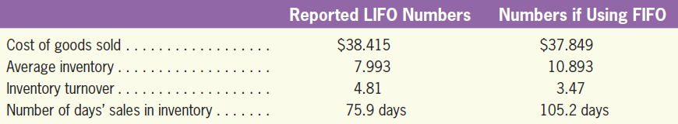
Comparison of the Three Cost Formulas*
LO7
Impact of the Cost Formula
Comparison for Caterpillar in 2008:
Higher
Shorter

Slide 64
Quiz Yourself
LO7
Zielesch Company reports the following activities during March related to its inventory of watches:
Determine (a) the cost of goods sold for the month and (b) the ending inventory balance for March 31 using LIFO cost formula.
Mar. | 1 | Beginning inventory consisted of 6 watches costing $40 each.
 | 5 | Purchased 10 watches costing $ 45 each.
 | 11 | Purchased 7 watches costing $48 each.
 | 22 | Purchased 11 watches costing $50each.
 | 27 | Sold 27 watches for $150 each.

Slide 65
Quiz Yourself
LO7
Solution
LIFO cost of goods sold
LIFO ending inventory
9 watches purchased March 5, $45 each | $ 405
7 watches purchased March 11, $48 each | 336
11 watches purchased March 22, $50 each | 550
Total cost of goods sold (27 units) | $ 1,291
6 watches from beginning inventory, $40 each | $ 240
1 watches purchased March 5, $45 each | 45
Total ending inventory (7 units) | $ 285

Slide 66
Perpetual System with LIFO and Weighted Average Cost*
Complications of the Perpetual System with LIFO and Weighted Average Cost
LO8
FIFO periodic and FIFO perpetual systems yield the same numbers for cost of goods sold and ending inventory.
Because no matter when sales occur, the “first in” units are always the same ones.
Computation of weighted average cost and LIFO under a perpetual system is complicated
The weighted average cost of units available for sale changes every time a purchase is made, and the identification of the “last in” units also changes with every purchase.

Slide 67
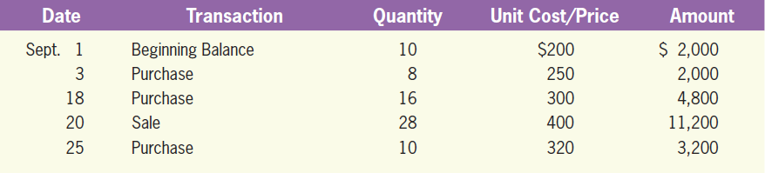
Perpetual System with LIFO and Weighted Average Cost*
LO8
Illustration
These perpetual system complications are illustrated below for Nephi.

Slide 68
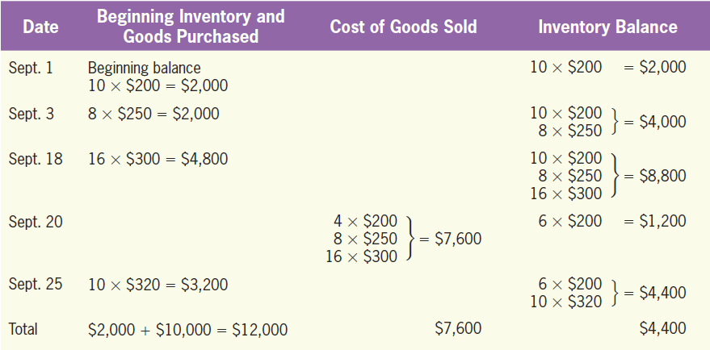
LIFO Cost Formula*
LO8
Illustration
The identification of the “last in” units must be evaluated at the time of each individual sale.

Slide 69
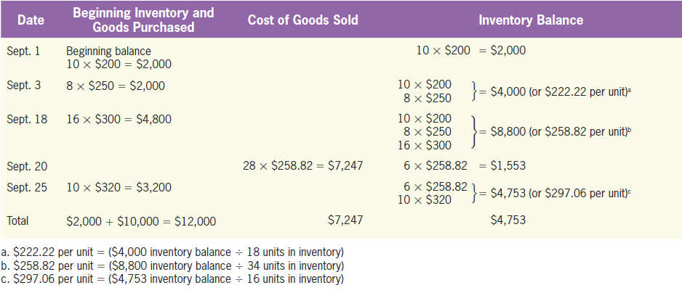
Weighted Average Cost Formula*
LO8
Illustration
A new weighted average cost per unit must be determined at the time each individual sale is made.

Slide 70
The Gross Margin Method*
Methods of Estimating Inventories
LO9
Used when a physical count of inventory is impossible or impractical.
Cost of goods sold and ending inventory are estimated using available information:
Beginning inventory
Purchases
Historical gross margin percentage

Slide 71
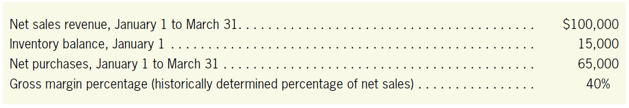
The Gross Margin Method*
LO9
Illustration
Assume the following data for Payson Brick Company:

Slide 72
The Gross Margin Method*
LO9
Illustration
 |  | Dollars | % of Sales
Net sales revenue
Cost of goods sold:
Beginning inventory
Net purchases
Total cost of goods available for sale
Ending inventory ($80,000 − $60,000)
Cost of goods sold ($100,000 − $40,000)
Gross margin ($100,000 × 0.40)
$100,000
100%
$15,000
65,000
$80,000
20,000
(3)
60,000
(2)
60%
$40,000
(1)
40%
Step 1: Gross margin is first determined by calculating 40% of sales
Step 2: Cost of goods sold is found by subtracting gross margin from sales
Step 3: The dollar amount of ending inventory is obtained by subtracting cost of goods sold from total cost of goods available for sale.

Slide 73
The Retail Inventory Method*
LO9
Estimate the cost of ending inventory by
Identifying the cost-to-retail percentage.
Then multiplying this percentage by the retailing price of ending inventory.

Slide 74
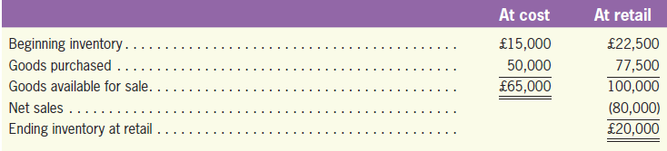
The Retail Inventory Method*
LO9
Illustration
Assume that Dyson Packard Company applies the retail inventory system to estimate its ending inventory.
0.65
Step 1: Cost-to-retail-ratio = £65,000 ÷ £100,000 = 0.65
Step 2: Ending inventory at retail = £100,000 – £80,000 = £20,000
Step 3: Estimated cost of ending inventory = £20,000 ⨉ 0.65 = £13,000

Slide 75
Quiz Yourself
LO9
Given the following information, estimate ending inventory using the gross margin method, and the retail inventory method, respectively.
Beginning inventory | $ 57,000
Purchases year to date | 186,000
Sales year-to-date | 320,000
Historical gross margin percentage | 35%
Cost-to-retail ratio | 60%

Slide 76
Quiz Yourself
LO9
Solution
Gross margin method:
Estimated cost of goods sold = $320,000 × 65% = $208,000
Beginning inventory | $ 57,000
Plus purchases | 186,000
Goods available for sale at cost | $243,000
Less cost of goods sold | 208,000
Ending inventory (estimated) | $ 35,000

Slide 77
Quiz Yourself
LO9
Solution
Retail inventory method:
Goods available for sale at retail
= $243,000 ÷ 60% = $405,000
Ending inventory at retail
= $405,000 – $320,000 = $85,000
Ending inventory at cost
= $85,000 × 60% = $51,000

